Slide 1
OŠ EUGENA KVATERNIKA ELEMENTARY SCHOOL EUGEN KVATERNIK CITY of VELIKA GORICA REPUBLIKA HRVATSKA REPUBLIC of CROATIA
CELEBRATIONS IN OUR COUNTRY
2019./2020.

Slide 2
Hello
friends!
Bok prijatelji!

Slide 3
Europe
Croatia

Slide 4
our capital city
our president Kolinda Grabar-Kitarović
Zagreb
our flag

Slide 5
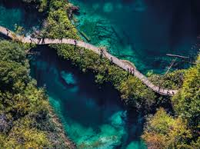
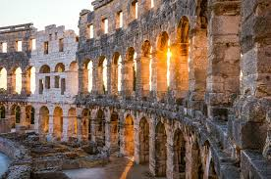
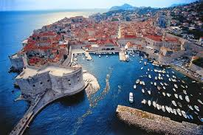
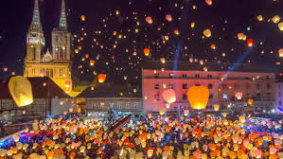
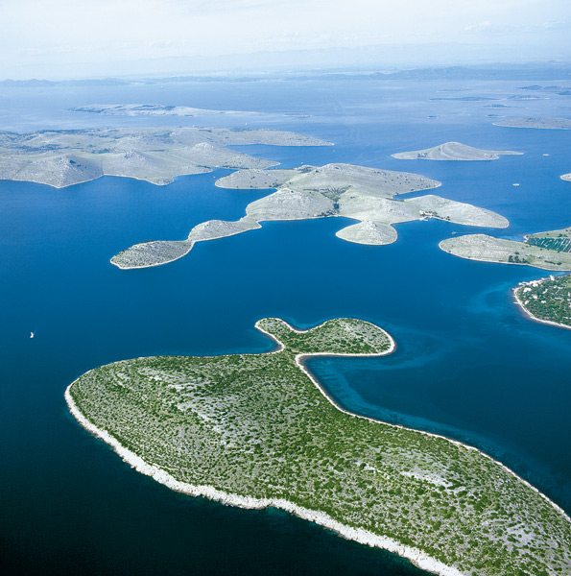
national park Plitvice lakes
amphitheatre in Pula
the Motovun hill
national park Kornati
Zagreb
old town Dubrovnik
OUR COUNTRY

Slide 6
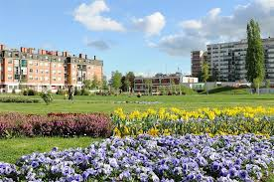
We live in Velika Gorica
Here!
°

Slide 7
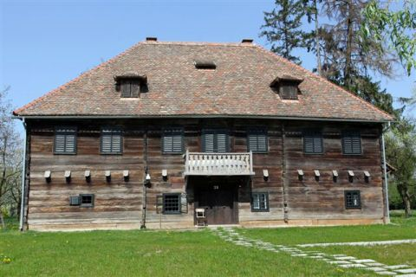
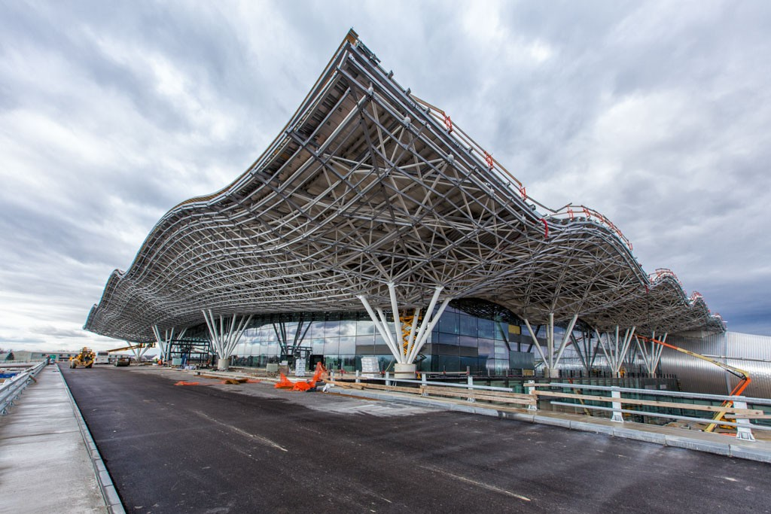
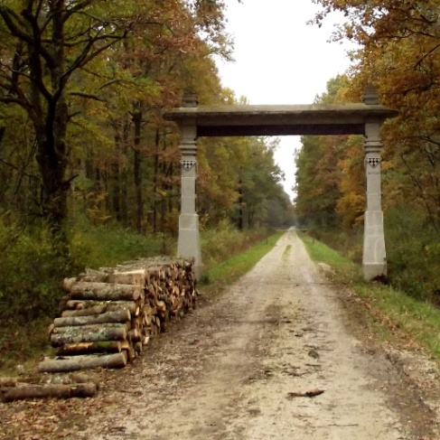
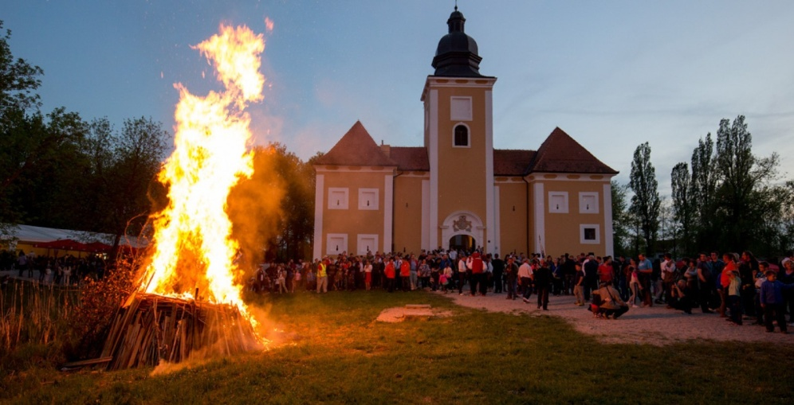
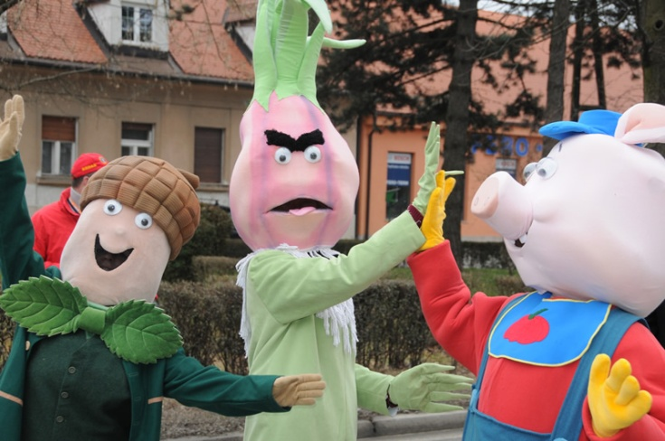
old architecture
folklore
Velika Gorica, the city of…
aviation
forests
history
carnival

Slide 8
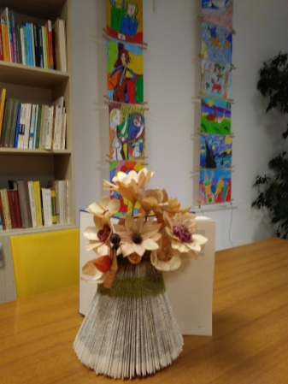
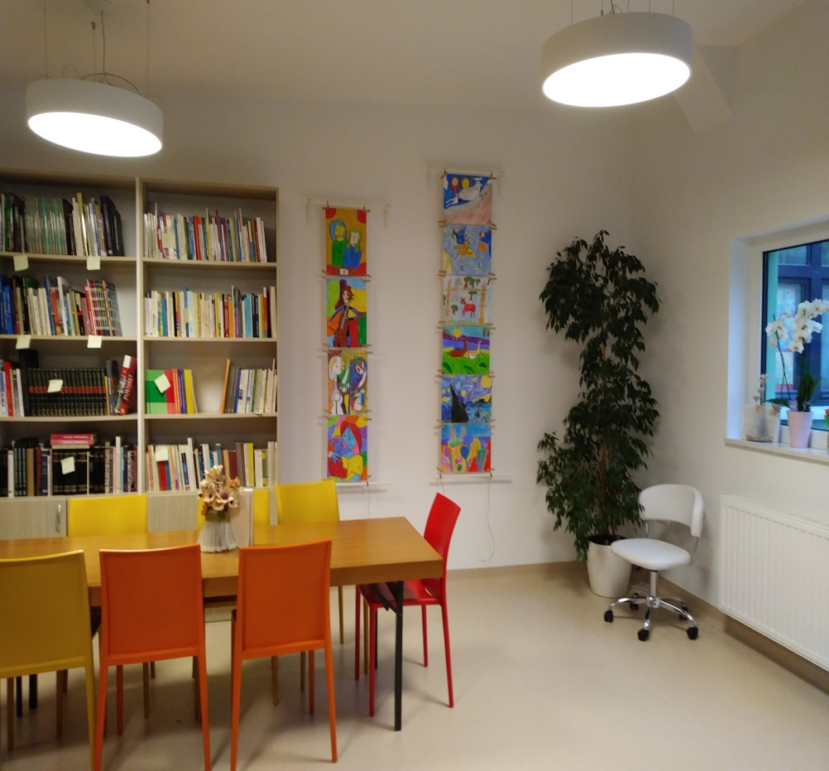
our school
our library

Slide 9
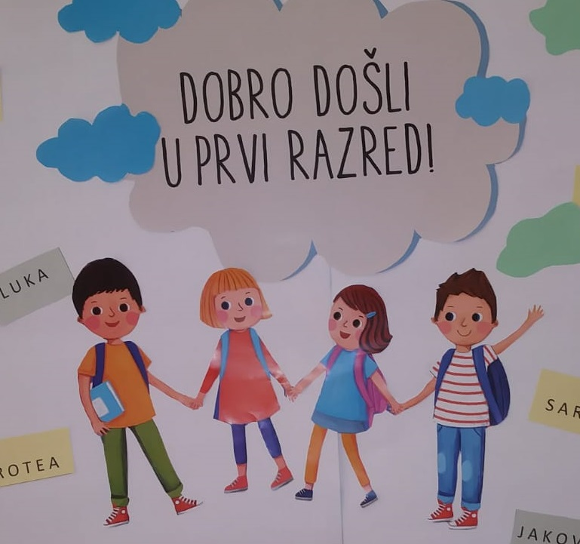
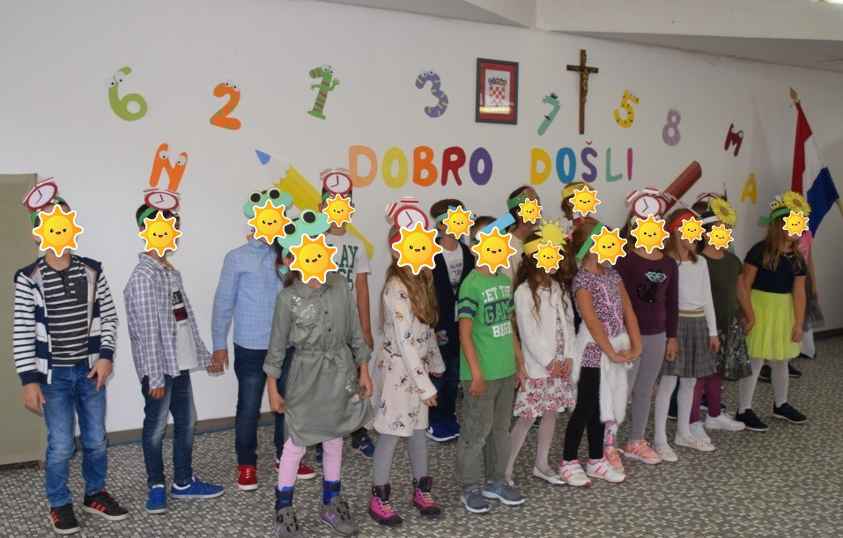
Our first celebration
First day of school
Greetings from Croatia

